Slide 1

AI for HR – Foundation
Premalatha T
https://www.linkedin.com/in/dr-latha-t-k-b21018128/

Slide 2
What is Artificial intelligence?

Slide 3
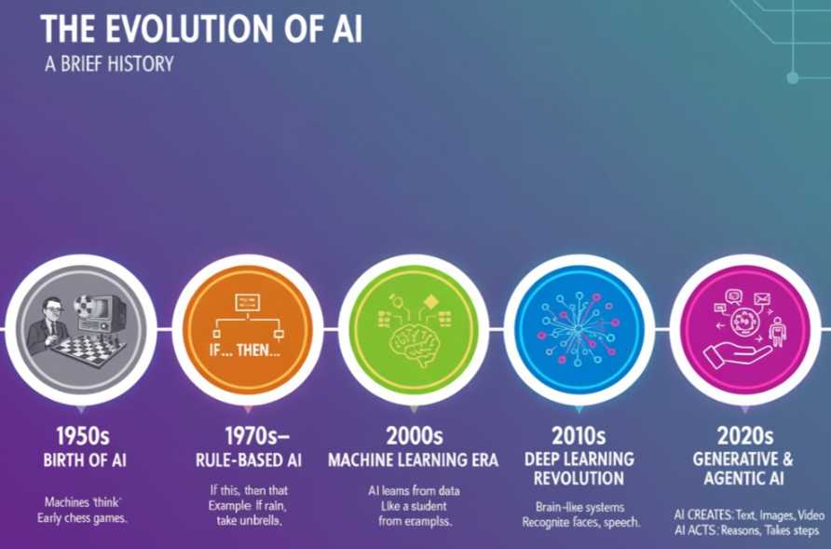

Slide 4
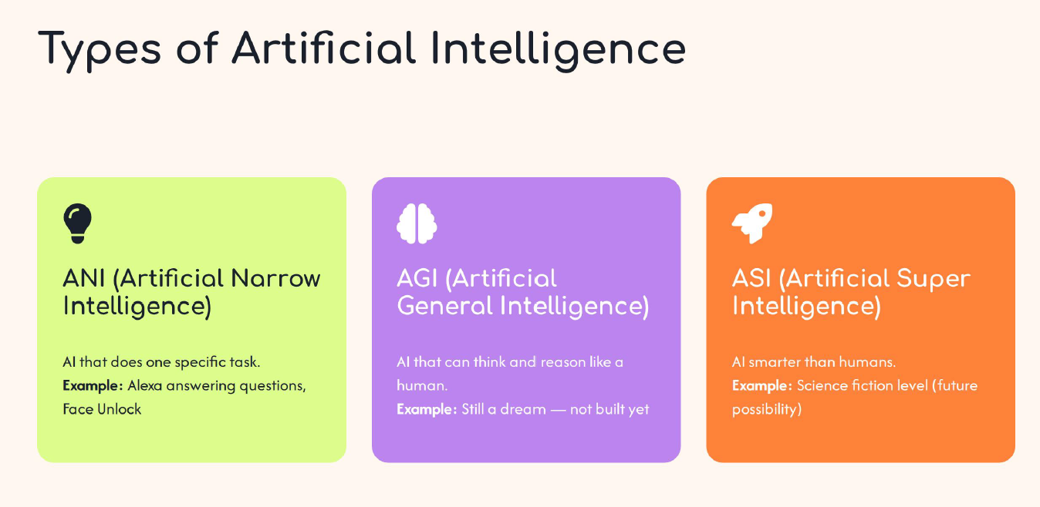

Slide 5
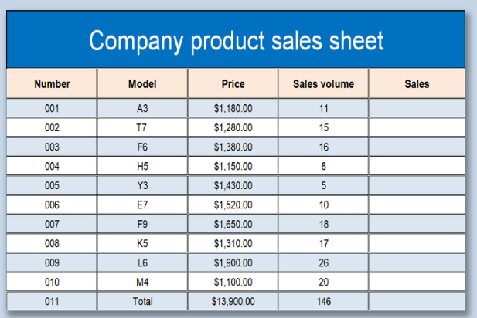
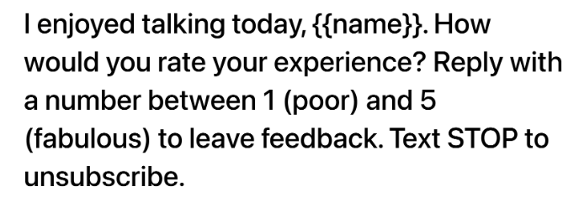

Slide 6

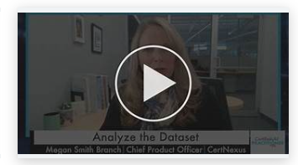
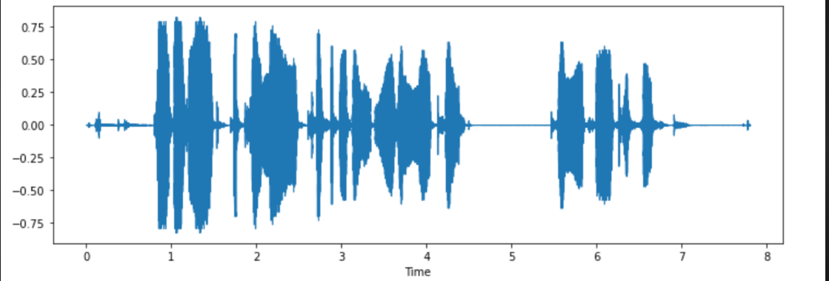

Slide 7
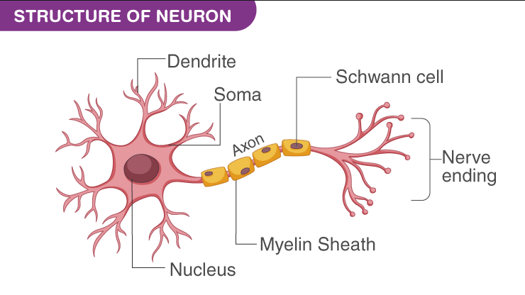

Slide 8
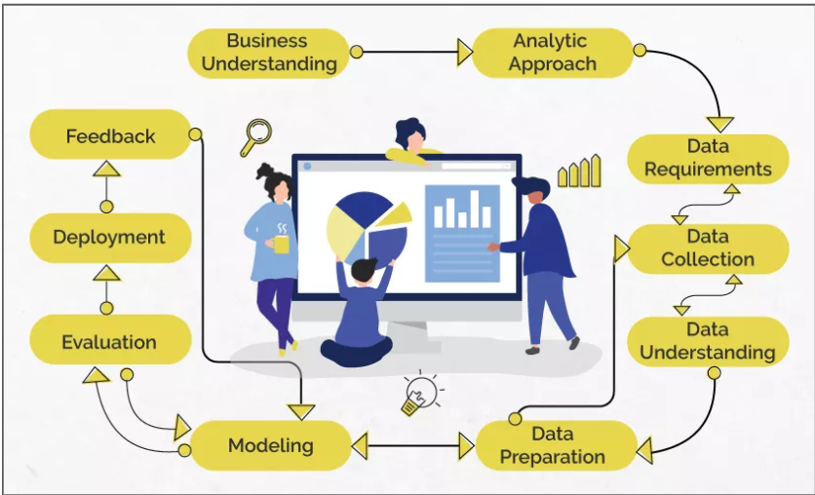

Slide 9


Slide 10
Usecases
IBM Watson predicts which employees are at risk of leaving
Companies like Amazon and Google use ML to analyze employee surveys, chat feedback, and emails to detect morale changes.

Slide 11
Usecases
PepsiCo uses ML models to predict staffing needs during peak demand seasons.
IBM’s HR chatbot “AskHR” uses ML and NLP to answer HR policy and payroll questions instantly.
ML in SAP SuccessFactors tailors onboarding checklists and training plans based on the new hire’s role and location.
Recommends learning courses using employee skill gaps and job role data.

Slide 12
Usecases
Flags unusual work patterns or absenteeism trends automatically.
Analyzes exit interviews to find top reasons for leaving (e.g., manager, workload).

Slide 13
Usecases
NLP-based chatbots answer FAQs like policy details or onboarding steps.
Detects negative or stressed tone in internal communications (aggregated, anonymized).
NLP reads HR policies or legal texts to find relevant clauses or inconsistencies.

Slide 14
Usecases
NLP clusters thousands of feedback comments into themes like “workload” or “manager issues.”
NLP analyzes exit interview text to find common reasons for attrition.
NLP creates summary reports from long HR survey texts or feedback documents.

Slide 15
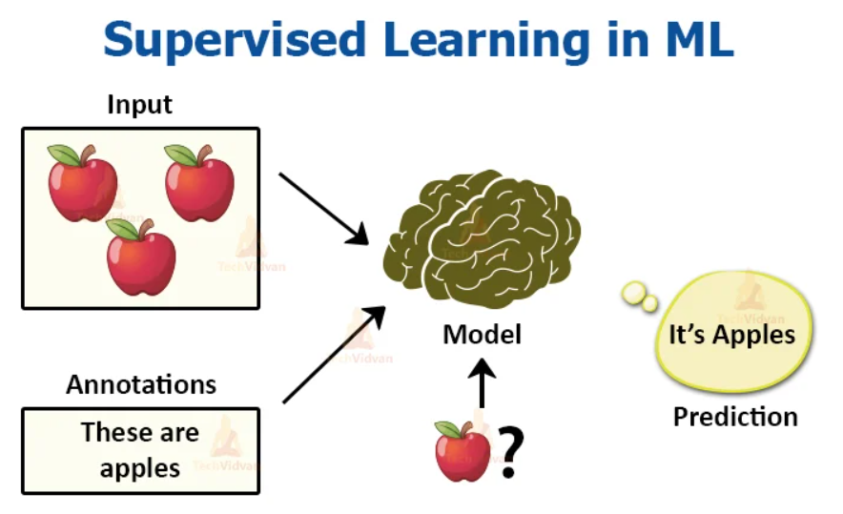
Analytic Approach

Slide 16
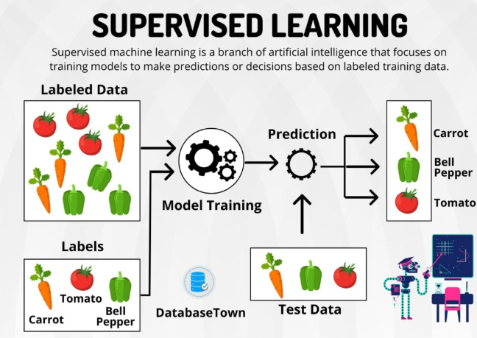

Slide 17
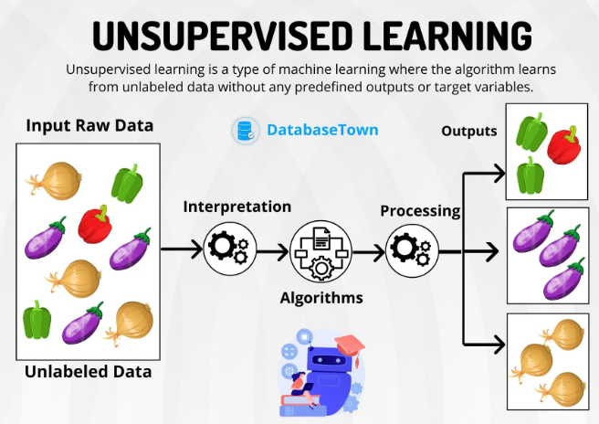

Slide 18


Slide 19


Slide 20


Slide 21


Slide 22


Slide 23


Slide 24
What is Generative AI?
https://analytics.zoho.in/workspace/486075000000002043/view/486075000000002005

Slide 25
What is LLM?
A Large Language Model (LLM) is an AI system trained on huge
amounts of text — like books, articles, and conversations — to
understand, generate, and respond in human language.
Examples:
ChatGPT, Google Gemini, Claude, Llama

Slide 26
What are AI agents?
AI Agents are autonomous systems that can reason, think, plan, figure out the relevant sources and extract information from them when needed, take actions, and even correct themselves if something goes wrong.

Slide 27
Usecases
The Participants can comeup with some usecases.

